Slide 1
PROJECT HOUSING
Submitted by: -
Dharambir Mahto

Slide 2
PROBLEM STATEMENT
&
UNDERSTANDING
Houses are one of the necessary need of each and every person around the globe and therefore housing and real estate market is one of the markets which is one of the major contributors in the world’s economy. It is a very large market and there are various companies working in the domain. Data science comes as a very important tool to solve problems in the domain to help the companies increase their overall revenue, profits, improving their marketing strategies and focusing on changing trends in house sales and purchases. Predictive modelling, Market mix modelling, recommendation systems are some of the machine learning techniques used for achieving the business goals for housing companies. Our problem is related to one such housing company.

Slide 3
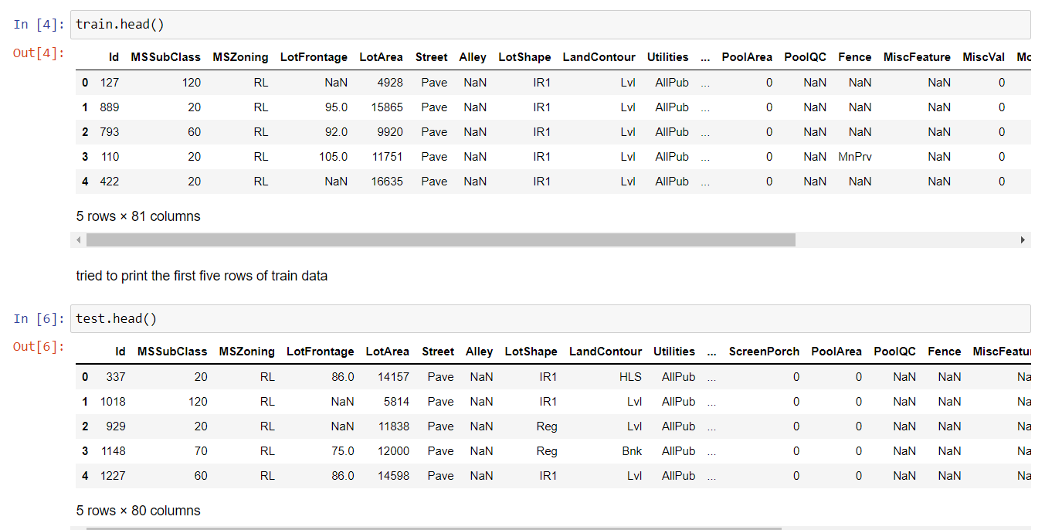
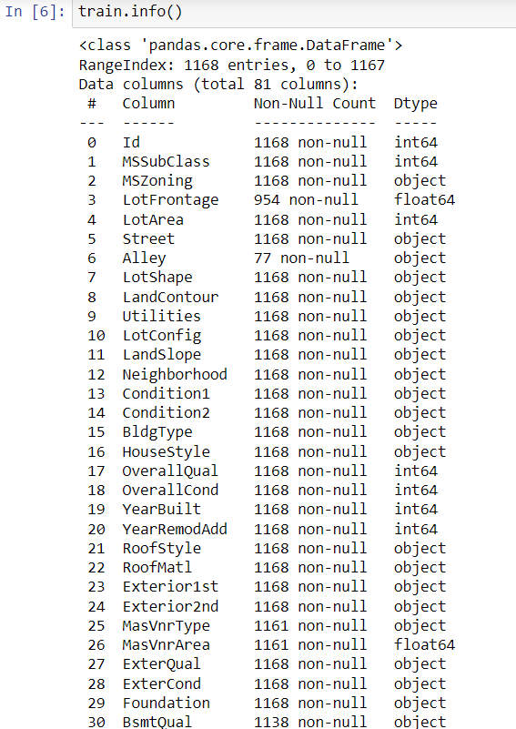
EDA STEPS AND
VISUALIZATION

Slide 4
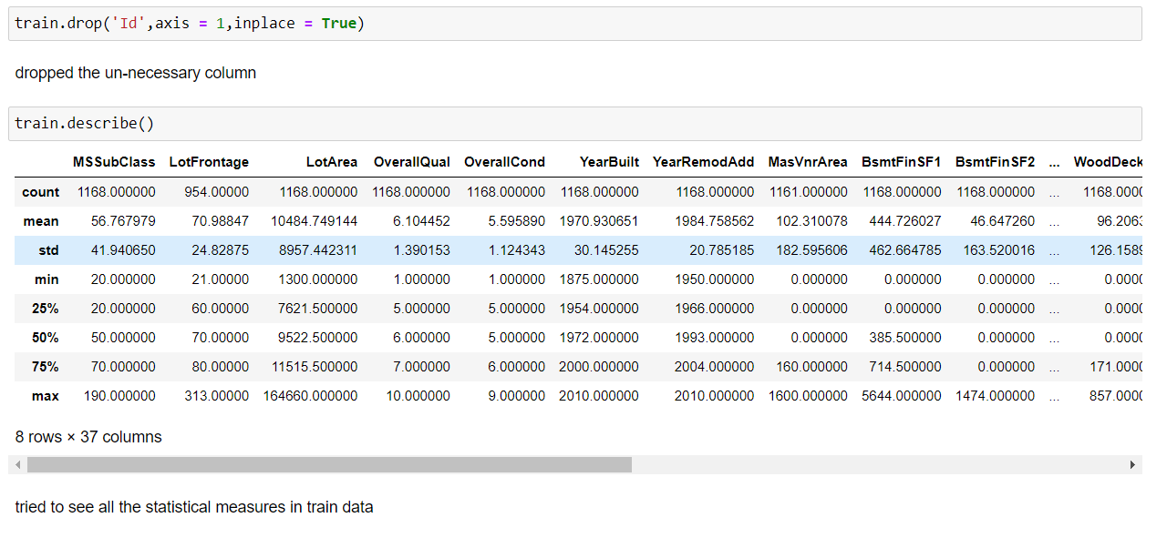
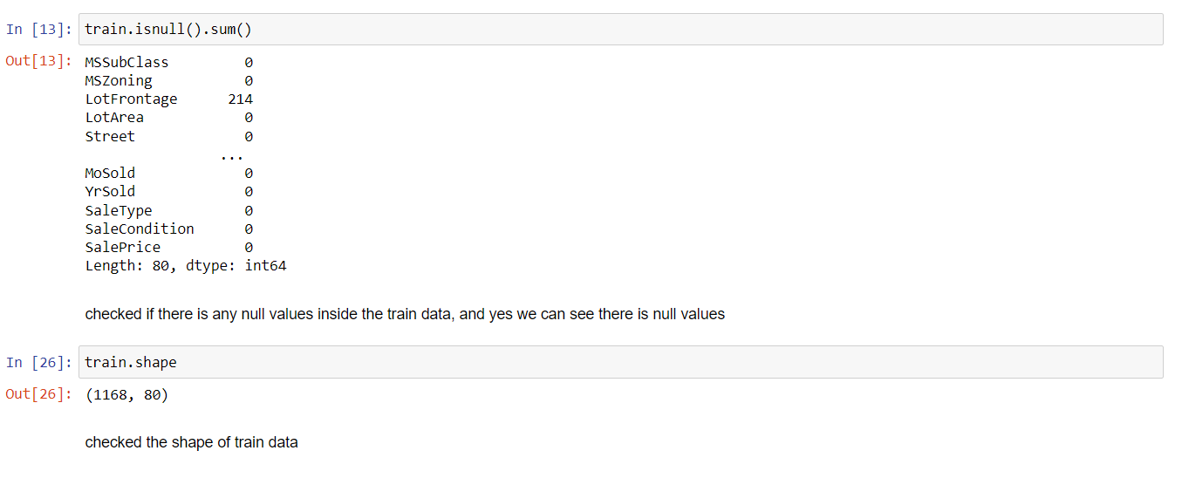

Slide 5
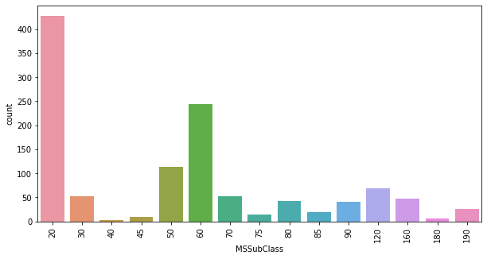
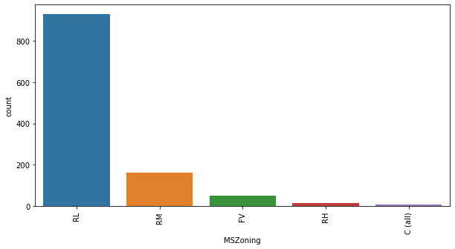
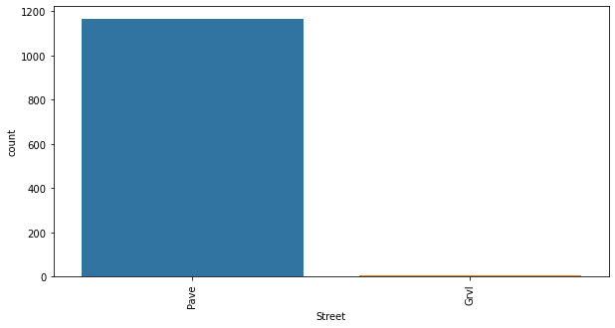
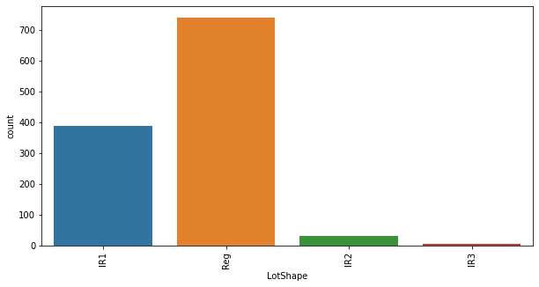

Slide 6
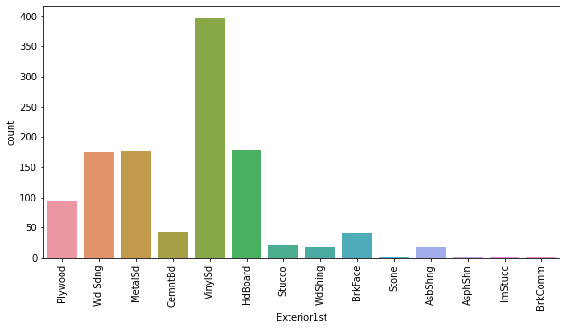
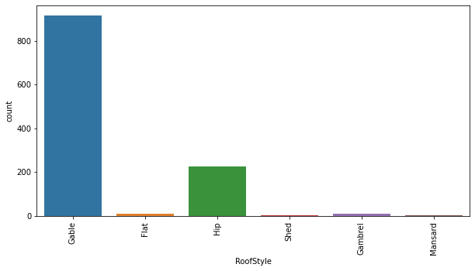
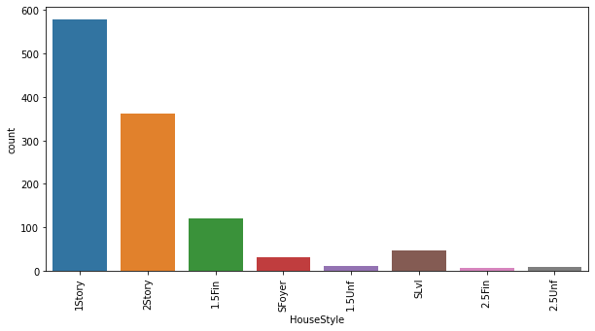
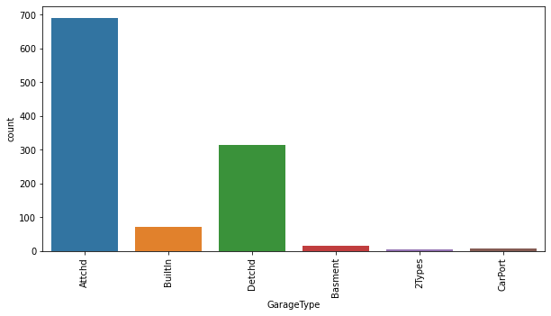

Slide 7
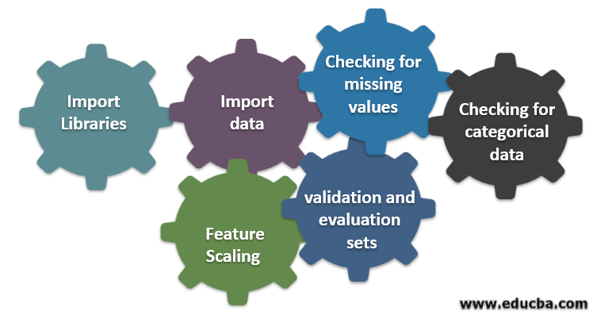
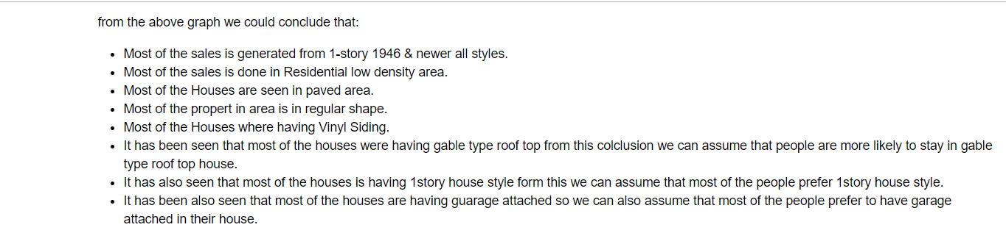
STEPS & ASSUPTIONS

Slide 8
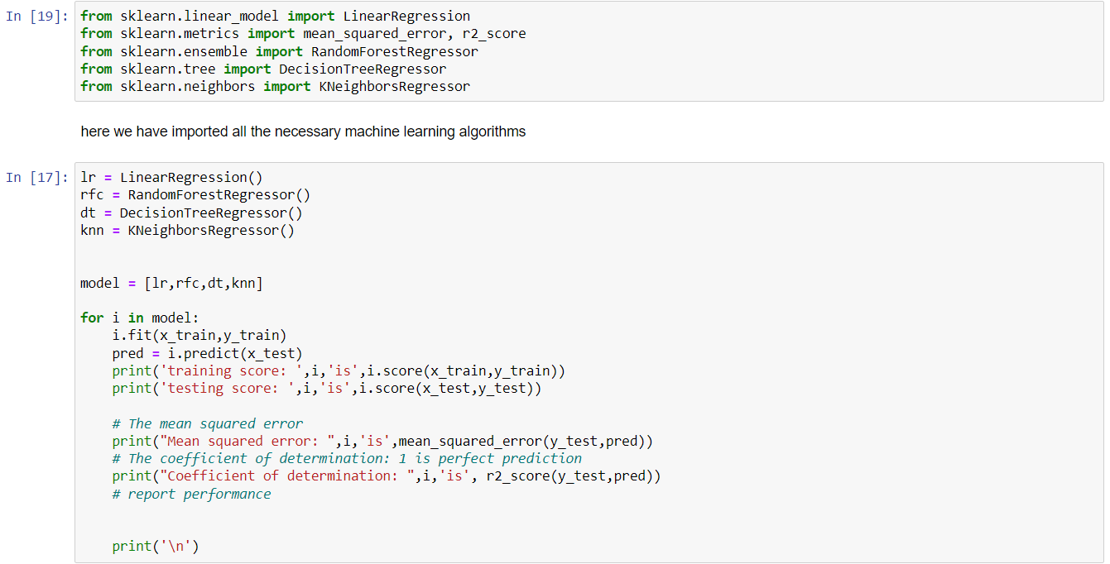
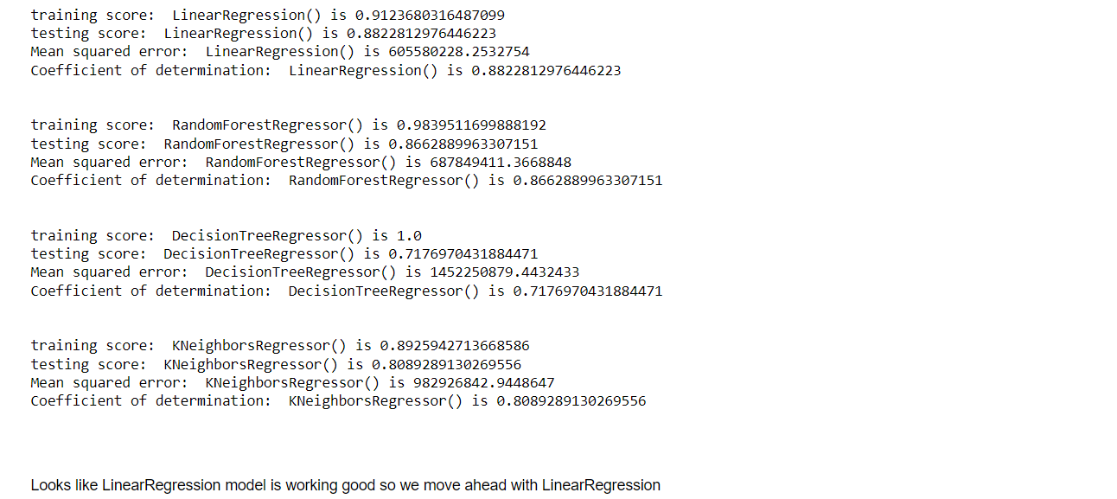
MODEL DASHBOARD

Slide 9
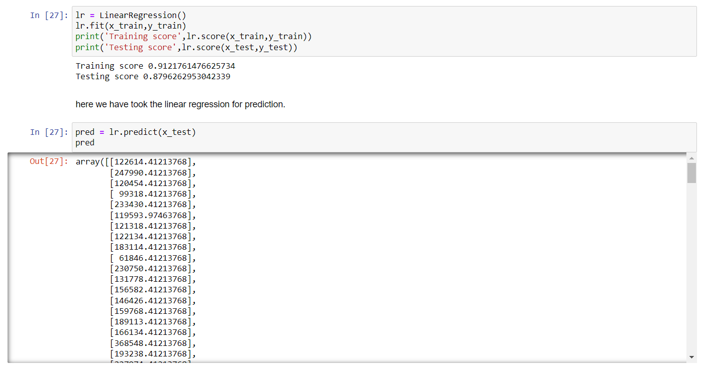
FINALIZED MODEL

Slide 10
CONCLUSION
Throughout this article we made a machine learning regression project from end-to-end and we learned and obtained several insights about regression models and how they are developed.
This was the first of the machine learning projects that will be developed on this series. If you liked it, stay tuned for the next article! Which will be an introduction to the theory and concepts regarding to classification algorithms

